Slide 1

Introduction to Django
Environment Setup, Framework, Architecture
Program: EDGE-CSE CUET DIGITAL SKILLS TRAINING
Course: Python (Django) [Intermediate]
Lecture: Training Session-06 Date: 4th October, 2024 Duration: (1+1) hours
Instructor: Tanveer Rahman, Sr. Software Engineer, Friends Corp. Chuo-ku, Tokyo, JP shakil10vr@hotmail.com, 01626735005

Slide 2
Agenda
Setting up the Django Environment
Overview of Django Framework
Django Architecture
Hands-on Tasks: Setting up your first Django project

Slide 3
What is Django?
Django is a high-level Python web framework that encourages rapid development and clean, pragmatic design.
Developed to handle the challenges of building complex, database-driven websites.
Key Features:
Object-Relational Mapping (ORM)
Admin Interface
Template Engine
URL Routing

Slide 4
Why Django?
Fast Development: Reduces development time with built-in tools.
Secure: Prevents common security mistakes.
Scalable: Powers some of the busiest sites (e.g., Instagram, Pinterest).
Versatile: Can be used to build anything from simple apps to complex enterprise solutions.

Slide 5
Setting Up Django Environment
Pre-requisites:
Python installed (version 3.8+)
Pip (Python package installer)
Creating a Virtual Environment:
Create: python -m venv env
Activate (Windows): env\Scripts\activate
Activate (Mac/Linux): source env/bin/activate
Install Django:
Use pip: pip install django
Verify installation: django-admin --version

Slide 6
Creating Your First Django Project
Start a New Django Project:
django-admin startproject blog
Navigate into your project: cd blog
Folder Structure:
manage.py: Command-line utility
/blog: Main project folder with settings
Running the Development Server:
python manage.py runserver
Open browser and go to: http://127.0.0.1:8000

Slide 7
Overview of Django Framework
Django is Built on the MVC Pattern (Model-View-Controller):
Model: Handles the database (data layer).
View: Represents the presentation logic (UI).
Controller: Controls the data flow into the model and updates the view.
In Django:
Model: Data structure (Django ORM).
Template: HTML templates for the UI.
View: Python logic that renders templates with data.
URLconf: URL dispatch system.

Slide 8
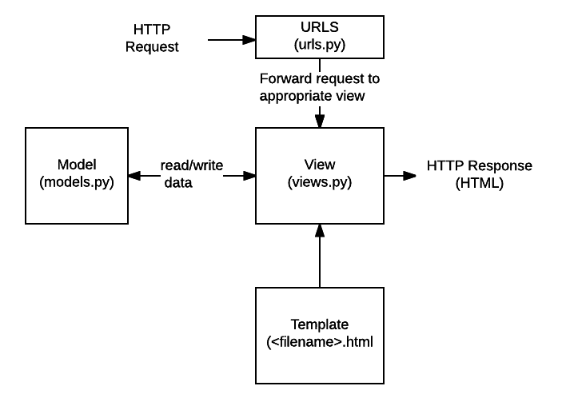
Django Architecture (How it Works)
URL Routing: URLs are mapped to specific views via URL patterns.
Views: Views handle the logic, fetch data from models, and return responses.
Templates: Views render data into HTML templates to be displayed.
Models: Represent and manipulate database data using ORM.

Slide 9
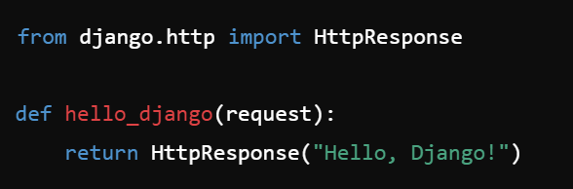
Understanding Django Architecture (Views)
Add a New View to Display “Hello, Django!”
In your Django app, locate the views.py file (or create one if it doesn't exist). Define a new view function that returns an HTTP response with the message "Hello, Django!".
view.py

Slide 10
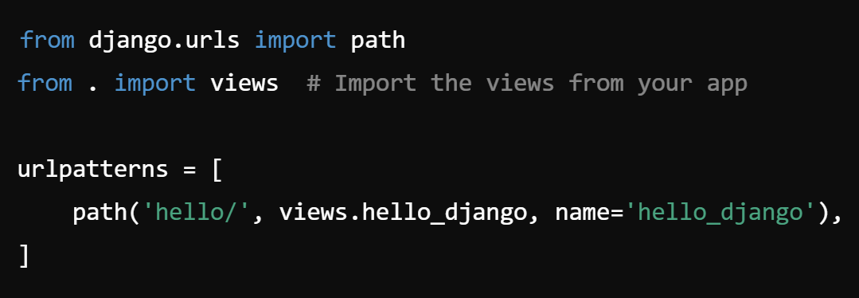
Understanding Django Architecture (URLS)
Create a URL Mapping for the View
In your Django project, locate the urls.py file (in your app or the project's root URL configuration) and add a URL pattern that maps a URL to the hello_django view.
urls.py

Slide 11
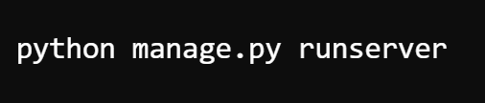
Understanding Django Architecture (VISIT URL)
Run the Development Server and Visit the URL
Start the development server using:
Visit http://127.0.0.1:8000/hello/ in your web browser. You should see the message "Hello, Django!" displayed as plain text.

Slide 12
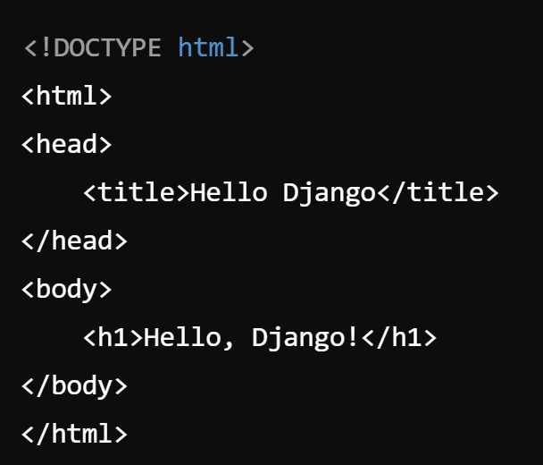
Understanding Django Architecture (TEMPLATES)
Create a Template to Display the Message
If you'd like to use Django's templating system, create a simple template instead of returning plain text. First, create a directory named templates in your app's folder, then create a template file called hello.html.
templates/hello.html

Slide 13
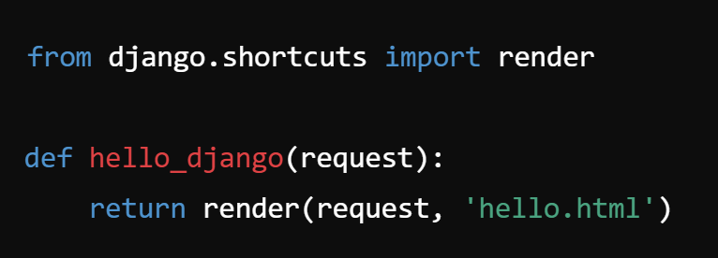
Understanding Django Architecture (RenderING TEMPLATES)
Modify the View to Render the Template
Instead of using HttpResponse, you can use Django's render function to display the template.
views.py (updated)
Visit http://127.0.0.1:8000/hello/ in your web browser. You should see the message "Hello, Django!" displayed within an HTML template.

Slide 14
ReCAP
Django setup process
Framework and MVC architecture
Practical tasks: starting a project, URL routing, creating views, templates

Slide 15

Q&A Session

